Slide 1
ISMS: ISO/IEC 27001 Roles & Responsibilities
<<Name>>
Nodal Information Security Officer
<<Centre City>>

Slide 2
In this session

Slide 3
Information Security Management System (ISMS)
A System
A systematic and structured approach to managing information so that it remains secure
The Standard
ISO/IEC 27001:2013 is the standard that sets out the specification for;
Establishing, Implementing, Maintaining, and Continually Improving the ISMS
The Factors
Influenced by the organization's
Needs and Objectives
Security Requirements
The organizational processes used and
The size and structure of the organisation
The Advantage
Having ISO/IEC 27001:2013 demonstrates an organizations due diligence and due care in identified risks and adopted measures to protect the organisation from information security breaches.

Slide 4
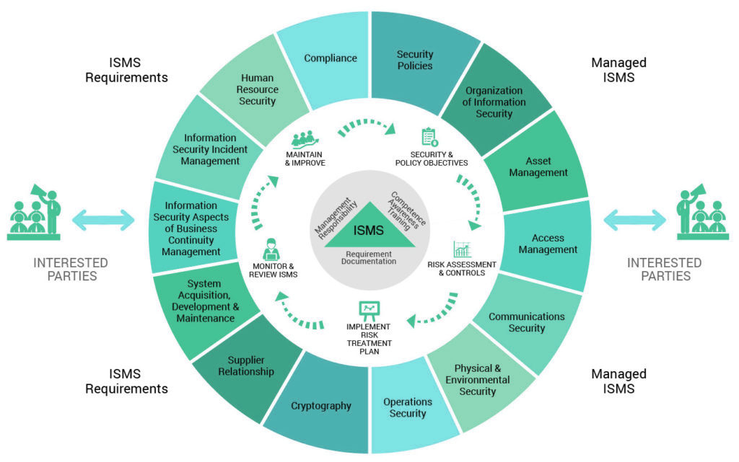
ISO/IEC 27001:2013 Certification

Slide 5
What The Standard Says
4. Context of the organization
5. Leadership
6. Planning
7. Support
8. Operation
9. Performance evaluation
10. Improvement
A.5 Information security policies
A.6 Organisation of information security
A.7 Human resource security
A.8 Asset management
A.9 Access control
A.10 Cryptography
A.11 Physical and environmental security
A.12 Operations security
A.13 Communications security
A.14 System acquisition, development, and maintenance
A.15 Supplier relationships
A.16 Information security incident management
A.17 Information security aspects of business continuity management
A.18 Compliance

Slide 6
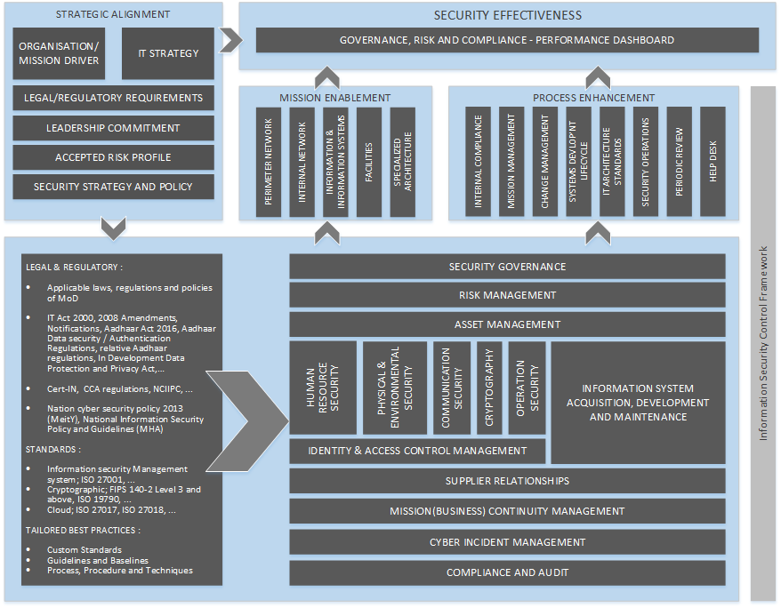
ISMS Implementation Framework
Strategic Alignment
Security Framework
Mission Enablement
Process Enhancement
Security Effectiveness
Standard
Guideline
Baseline
Policy
Procedure

Slide 7
Top Down Approach
Governance
Management
Operation
Information Security Governance
Leadership Commitment
Information Security Program
Information Security Policy(s)
Security Planning
Resources appropriation and communication
Performance evaluation and Improvement
Risk Management
Asset Management
Change Management
Supplier Management
Mission (Business ) Continuity Planning of Information security
Cyber Incident Management
Compliance Management
Information Security Training and Awareness Program
Access Control
Cryptography Controls
Physical & Environ… Security
System Acquisition, Development and Maintenance
Communication Security
Security Operations
Red & Blue Team Exercise

Slide 8
Approach for ISMS
ISMS shall be implemented for entire CDAC functions as mandated by MeitY
Unified strategy and framework as endorsed by the Steering Committee and approved by DG shall be applicable for all Centres
The security policies and standard procedures shall be applicable across all CDAC centres
Each Centre may have additional policies to cater specific functions/ activities
Each Centre shall obtain, maintain and renew the ISMS Certifications regularly
Resource optimisations shall be ensured though a centralised approach
Each Centre shall establish Department of Information Security Assurance (DISA)
Each Centre shall establish, implement, operate, maintain, review and improve the ISMS based on the approved Organisational framework

Slide 9
ISMS Implementation –
The Progress

Slide 10
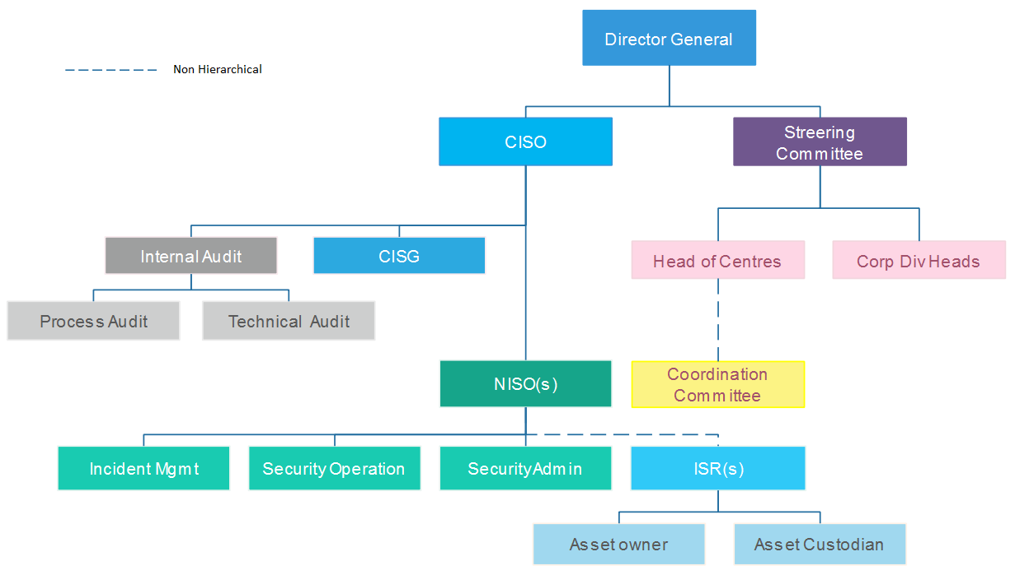
ISMS Organisation Structure - Proposed

Slide 11
Department of Information Security Assurance
CISO
CISG
Internal Audits
Security Administration
NISO
Security Operation
Incident Management

Slide 12
Formation of the Core and Implementation Teams
Implementation Team - NISO
Core Information Security Group
Smt. R. Ananthalakshmi Ammal, CISO
Shri. Satyaswarup Yerramilli, CDAC-Pune
Shri. Aneesh Kumar K B, CDAC- Thiruvananthapuram
Shri. Dittin Andrews, CDAC-Bangalore
Shri. Raakesh T, CDAC-Mumbai
Bengaluru | Shri. Sreekantha BA (ISMS) Shri. Gokulatheerthan M (CCMP)
Chennai | Shri. P. Prasanna
Delhi | Shri. Himanshu Ranjan
Hyderabad | Smt. Indraveni
Kolkata | Shri Anupam Chanda
Mohali | Shri. Sanjeev Kumar
Mumbai | Shri Anupam Saxena
Noida | Shri. Varun Jain
Pune | Smt. Jyoti Dahiwele Shri. Jijish Arjjan
Silchar | Shri. Abhijit Das
Thiruvananthapuram | Smt. Dija S
Nodal Information Security Officer
Incident Response
Security Operation
Security Administration
Integrated Infrastructure to be developed
Information Security Representative
ISR’s to be nominated for departments or projects in the centre

Slide 13
Developing Cyber Crisis Management Plan
CCMG
NCMC
Document
Cyber Crisis Management Group for CDAC formed on 11/11/2019
Nodal Crisis Management Cell (to be) formed in each Centre
First version of CCMP document prepared and submitted to CERT-In / MeitY on 05/02/2020

Slide 14
Asset Identification & Classification
Initiated in September 2019 as part of ISMS as well as CCMP
Challenges exist in manually identifying the information systems and the related assets in hardware, software and other forms
Proposed to implement DARPAN NMS to discover all the networked assets in the form of hardware and software
Notes:
This template was inserted from Power-user, the productivity add-in for PowerPoint, Excel and Word.
Get thousands of templates, icons, maps, diagrams and charts with Power-user. Visit https://www.powerusersoftwares.com/!

Slide 15



Cyber Security Preparedness
1
National Cyber Security Framework
2
International Standards and Best practices
3
Tailored Standards, Guidelines and Baselines

Slide 16
Standardization
Policy
Based on the legal and regulatory requirements, CISG developed draft of the cyber security policy aligned with the organizations mission.
1
Standards
To ensure a uniform mandatory practice across the organization, CISG shall develop common standards and baselines(hardening) supporting the policy.
2
Guidelines
To address the administrative, technical and physical cyber security requirements, Guideline(s) shall be developed to support standard(s) and procedure(s) applicably.
3
4
Procedures
Detailed step by step tasks shall be developed addressing the tactics, techniques and procedure for cyber security establishment, management, operation, monitoring, review and improvement by the NISO & ISR.

Slide 17
Developed a Common Policy Framework
Following draft documents prepared / In Progress
Information Security Policy Manual
01
Information Security Governance
02
ISMS Manual
03
ISMS Scope and Statement of Applicability
04
Policies, Guidelines and Procedures
05

Slide 18
Document is fundamental, but
People
Knowledge, Skill and Ability drives success.
Process
A standardized process makes an organisation efficient in its delivery. A system in decision making.
Technology
A complement to the value system, in optimization resource and scaling efficiency.

Slide 19
Information Security Policy
C-DAC is committed to establish, maintain, and improve the holistic security of its information, information systems, facility assets and safety of its human resources.
1
Defines the general security framework for C-DAC’s Information Systems and the information stored, processed and communicated.
2
Applies to all users of C-DAC information assets and supporting facilities, including but not limited to employees, contractors, consultants, third parties, auditors, visitors.

Slide 20
Information Security Vision
Establish and maintain a resilient cyber ecosystem to the changing threat landscape
Information Security Governance program
Internal Audit program
Risk Management program
Compliance Management program
Business Continuity program
Information Security Training and Awareness program
Cyber Crisis and Incident Management program

Slide 21
Data Collection leading to ISMS Policies & Procedures
Understand the information assets of CDAC and classify them - Initiated
Understand the context of the organisation - Initiated
Perform Gap Analysis – To be initiated
Perform Risk Assessment – To be initiated
Business Impact Analysis – To be initiated
Collaboration Server was hosted in Thiruvananthapuram with svn support for document preparation, review and sharing

Slide 22
ISMS Implementation –
The way forward

Slide 23
ISMS Roadmap – Where Are We Now?
7
6
7. Certification Audit
Stage 1 Audit
Stage 2 Audit
5. System Rollout
Process Implementation
Closure of identified gaps
Awareness & Training sessions
5
6. ISMS Readiness Check
ISMS Audit Training
ISMS Internal Audit
Closure of Identified Non compliances (NCs)
2. Information Assets Identification & Risk Assessment
Identification of Information Assets
Gap Analysis & Risk Assessment
Risk Treatment ( Addressed through 3,4 & 5)
Statement of Applicability
4
4. Technical and Physical controls Implementation
Network, System, Applications, Database level controls
User level Controls
ISMS Planning
Setup ISMS through a Governance and Management Framework
ISMS Objectives, Plans, Roles & Responsibilities
ISMS Implementer Training
3
3. Policies, Process Definition & Review
ISMS Policies and Procedures
Policies Awareness Sessions
Policies and Procedures Approvals
2
1

Slide 24
Coordination Committee
Shall address information
security risk profile and define
acceptable risk
Headed by ED/CH,
assessing and approving
budgets
Forum for streamlining and
optimizing resource
Review ISMS effectiveness
Regularly

Slide 25
Coordination Committee
Information security coordination committee at the centre level shall be, heads of all departments or projects, convened by NISO, ISR’s and chaired by the head of the centre.
Head of the centre shall act as security program owner at the centre and nominate a Nodal Information Security Officer to oversee and ensure compliance to organisation, legal, regulatory, statutory, and contractual obligation requirements of ISMS
Ensure adequate resources and support for the effective implementation of ISMS across the centre.
Shall constitute the Nodal Crisis Management Group (NCMG).
Assess and approve centre wide information security policy and process for information security management system. Assess exception to policy by any project or department.
Continued..,

Slide 26
Coordination Committee
Ensures ISMS (Policies and Procedures/Processes) documented information’s are implemented and enforced in the scope of the centre;
Shall regularly review the information security effectiveness and opportunity for improvement.
Shall communicate the information security need and expectation to subsequent department/project.
Shall address the information security risk profile and define acceptable risk appetite.
Assessing and approving the budgetary needs for ISMS in the centre.
Shall act as a forum for streamlining and optimizing common resources and infrastructures supporting the processes in the centre.

Slide 27
ISR – Department or Project
Implement and maintain
ISMS
Ensure security requirement
in agreements
Information Security
Risk Owners
Ensure compliance
requirements

Slide 28
Information Security Representative - ISR
Group head shall be risk owner of the information, information systems and information processing facility of the department or project and shall be the functional owner of the information assets in the group, and may delegate ownership and custodianship.
Group head may nominate an Information Security Representative to implement compliance to organisation, legal, regulatory, statutory, and contractual obligation requirements of ISMS.
Responsible for compliance to information security policy, procedures and guidelines to protect the information and information systems of the respective department or project.
Shall collaborate with centre NISO for information security program maturity enhancement.
Responsible of implementing applicable policy and guidelines in the department, project or member(s).
Continued..,

Slide 29
Information Security Representative - ISR
Responsible for incorporating security principles and practices in software or hardware development lifecycle process.
Support NISO with data collection on information and information processing system relevant to the department or project.
Collaborate and support NISO with asset management, risk assessment, Incident Management, Security operation, Business Continuity and Disaster recovery, Compliance requirements to, identify, implement, operate, monitor, review, maintain and improve information security in the project or the department.
Ensure adequate information security awareness training for all members of the group.
Ensure applicable non-disclosure-agreement are acknowledged by the group users for sensitive project requirements.
Continued..,

Slide 30
Information Security Representative - ISR
Ensure change and configuration management process are ensured by the group.
Report information security incident to the NISO (timely) [Incident Management].
Ensure security requirements are stipulated in supplier contracts, agreements, MoUs and project proposals.
Support periodic internal and external audits.

Slide 31
NISO - Centre
Implement and maintain
ISO 27001
Support Internal &
External Audit
Oversee Security Administration
Security Operation
& Incident Management
Development and Maintain
Policy & Documented
information

Slide 32
Nodal Information Security Officer
Shall report to CISO on information security establishment requirements of the centre.
Shall be responsible for ISO 27001:2013 standard, liaison for certification and maintain the certification.
Leads the efforts in implementing the action plan of the CISO at the centre.
Implement information security program at the centre.
Define the applicable scope of ISMS.
Understand the organisation context for the centre.
Document internal and interested parties’ needs and expectations.
Ensure information security requirements are addressed in all projects, operations, external parties, interested parties, service providers and suppliers.
Identify and maintain applicable controls for Statement of Applicability.
Carry risk assessment in the centre in coordination with the ISR’s.
Identify cost effective risk treatment solutions.
Continued..,

Slide 33
Nodal Information Security Officer
Implement or develop information security policy, procedures, guidelines, templates and forms applicable to the centre in consultation with ISR’s.
Implement and maintain the secure architecture for the centre.
Implement approved security controls to ensure confidentiality, integrity and availability of the identified information assets and information systems as per risk treatment plan.
Manage the security administration and security operation team.
Co-ordinate with incident management team.
Implement the Business Continuity and disaster recovery plan, carry business impact analysis and identify appropriate controls.
Develop, update and maintain appropriate level of adequate documented information as manual, policies, procedures, guidelines, templates and forms.
Implement the defined and approved controls, justifying any exception to the controls.
Support and coordinate periodic internal and external audits.
Continued..,

Slide 34
Nodal Information Security Officer
Prepare audit, non-conformity closure and action taken status report for CISO.
Implement, operate and maintain data protection and privacy of employee, citizen and customer data, requirements.
Implement and maintain security requirements stipulated in supplier contracts, agreements, MoUs.
Implement and monitor time source synchronization for electronic system in C-DAC.
Monitor the effectiveness of information security training and awareness program for C-DAC.
Endorse secure development lifecycle practices in software and hardware development through principles and practices.
Communicate training requirements to CISO.
Monitor the effectiveness of the implemented controls.
Endorse and encourage incident reporting, analyse, respond, contain and control incidents.

Slide 35
Employees
Responsible for compliance to information security policy, procedures and guidelines to protect the information and information systems used, maintained or owned.
Report suspicious cyber activity, events or incidents to the ISR/ NISO [Incident Management].
Support organisation in maintaining a secure environment.
Support audits and technical review.

Slide 36
Integrated Infrastructure Implementation Steps
Identification of in-house/ Open source tools
DARPAN NMS for network monitoring and management
SARAN Nxt Gen Service Desk for Incident Management
Honey- Net for Threat Management
eSign for digital signature / ePraman for single sign-on, multifactor authentication
ISEA – Meghshishak for Information Security Training
………………………………………………...
1
Setting up of Security Operations Centre for CDAC
Tender published and Technical bids evaluation in progress
Team members trained for security operations on 24X7 basis
  Level 3 Analyst - SANS Certified ( 1 Member)
  Level 2 Analysts – Trained in HP Arc Sight, RSA NetWitness and Certified SOC Analysts and Certified Ethical Hackers ( 3 Members)
  Level 1 Analysts – Certified SOC Analysts ( 12 Members)
2

Slide 37
NISO may add further contents

Slide 38
The Way Forward
Internal Audit program.
Information Security Governance program;
Compliance Management program;
Risk Management program;
Business Continuity program;
Information Security Training and Awareness program;
Cyber Crisis and Incident Management program;

Slide 39
Milestones to Achieve
SN | Action Items | Actions by | Target End Dates
1 | Convention of First Steering Committee | CISO | 25th June 2020
2 | Approval and Release of Information Security Policy & Information Security Governance Documents | DG & CISO | 30th June 2020
3 | Formation & Convention of Coordination Committee at Centre Level | ED / CH & NISO | 3rd July 2020
4 | Finalisation of Statement of Applicability in each Centre | ED / CH & NISO | 31st July 2020
5 | Security Audit of IT infra in each Centre | NISO, CISO | 31st Aug 2020
6 | Risk Assessment in each Centre | ISR, NISO, CISG | 31st Aug 2020
7 | Implement BCP, Incident Management in each Centre / Integrated | ISR, NISO, CISG | 11th Sep 2020
8 | Convention of Steering Committee | CISO | 15th Sept 2020
9 | Control Implementation in each Centre | ISR, NISO, ED/CH | 31st Oct 2020
10 | Awareness Training | ISR, NISO, ED/CH | 30th Oct 2020
11 | Internal Audit & Corrective Actions | ISR, NISO, CISG | 16th Nov 2020
12 | Convention of Steering Committee and plan for Certification Audit | CISO, NISO | 11th Dec 2020

Slide 40
Before |After – Security Best Practices
Before
Firefighting mode
Bottom up silo approach
Not accountable or transparent
Un uniform practice in organization
High risk of information loss
After
Standardization and Consistency
Sets Direction
It clarifies goals and requirements
Evidential and Auditable
Compliance to law and regulation
Security Policy, Standards, Guidelines, Baselines and Procedures with leadership commitment sets directions in the organizations cyber security requirements and practices.

Slide 41

Thank You
<<email>>@cdac.in | www.cdac.in
धन्यवाद आभार આભાર ਧੰਨਵਾਦ ধন্যবাদ நன்றி നന്മ നേരുന്നു
One Vision. One Goal... Advanced Computing for Human Advancement…

